Slide 1
Java Script…

Slide 2
JavaScript is one of the 3 languages all web developers must learn:
1. HTML to define the content of web pages
2. CSS to specify the layout of web pages
3. JavaScript to program the behavior of web pages
JavaScript is an object-based client-side scripting language, which is very popular and is used to create dynamic and interactive web pages.
It is lightweight and most commonly used as a part of web pages, whose implementations allow client-side script to interact with the user and make dynamic pages.
It is an interpreted programming language with object-oriented capabilities.

Slide 3
JavaScript is a cross-platform, object-oriented scripting language used to make webpages interactive (e.g., having complex animations, clickable buttons, popup menus, etc.).
There are also more advanced server side versions of JavaScript such as Node.js, which allow you to add more functionality to a website than downloading files (such as real time collaboration between multiple computers).
Inside a host environment (for example, a web browser), JavaScript can be connected to the objects of its environment to provide programmatic control over them.

Slide 4
JavaScript Development Tools
You can start with a simple text editor such as Notepad.
Since it is an interpreted language inside the context of a web browser, you don't even need to buy a compiler.
Some of the very nice JavaScript editing tools are as follows:
Microsoft FrontPage − Microsoft has developed a popular HTML editor called FrontPage. FrontPage also provides web developers with a number of JavaScript tools to assist in the creation of interactive websites.

Slide 5
Macromedia Dreamweaver MX − Macromedia Dreamweaver MX is a very popular HTML and JavaScript editor in the professional web development crowd. It provides several handy prebuilt JavaScript components, integrates well with databases, and conforms to new standards such as HTML and XML.
Macromedia HomeSite 5 − HomeSite 5 is a well-liked HTML and JavaScript editor from Macromedia that can be used to manage personal websites effectively.

Slide 6
Overview of Java Script…
Java Script, which was originally named LiveScript was developed by Netscape.
In 1995, the LiveScript became a joint venture of Netscape and Sun Microsystems and its name was changed to Java Script.
Java Script can be divided into 3 parts: the core; client side and server side.

Slide 7
The core is the heart of the language, including its operators, expressions, statements and subprograms
Client-side Java Script is the most common form of the language and is a collection of objects that support control of a browser and interactions with the users.
The script should be included in or referenced by an HTML document for the code to be interpreted by the browser.
Server-side Java Script is a collection of objects that make the language useful on a web server (NodeJS).

Slide 8
Server side JavaScript is used far less frequently than client-side Java Script.
Client-side Java Script is an HTML embedded scripting language.
We refer to every collection of Java Script code as a script.

Slide 9
Java Script and Java…
One important difference is support for object-oriented programming;
Java Script doesn’t support the object-oriented software development paradigm, It is an object based language.
Java is a strongly typed language; Types are well known at compile time and operand types are checked for compatibility;
Variables in Java Script need not be declared and are dynamically typed, making compile time type checking impossible.

Slide 10
Objects in Java are static in the sense that their collection of data members and methods are fixed at compile time.
Java script objects are dynamic – the no of data members and methods of an object can change during execution.
The main similarity between Java and Java Script is the syntax of their expressions, assignment statements and control statements.

Slide 11
Many of us have a misconception that Java script is an object oriented language. But, the truth is Java Script is an Object Based Language.
Object Based languages are different from Object Oriented Languages:
Object Based Languages
Object based languages supports the usage of object and encapsulation.
They does not support inheritance or, polymorphism or, both.
Object based languages does not supports built-in objects.
Javascript, VB are the examples of object bases languages.
Object Oriented Languages
Object Oriented Languages supports all the features of Oops including inheritance and polymorphism.
They support built-in objects.
C#, Java, VB. Net are the examples of object oriented languages.

Slide 12
Uses of Java Script…
The original goal of Java Script was to provide capability at both the server and the client ends of a web connection.
Client side Java Script is embedded in HTML documents (either physically or logically) and is interpreted by the browser
This transfer of load from the overloaded server to the normally under loaded client can benefit all other clients.
Java Script is easier to learn than Java
Interactions with users through form elements, such as buttons and menus can be conveniently described in Java Script
The development of Document Object Model (DOM), allows Java Scripts to access and modify the CSS properties and content of any element of a displayed HTML document.

Slide 13
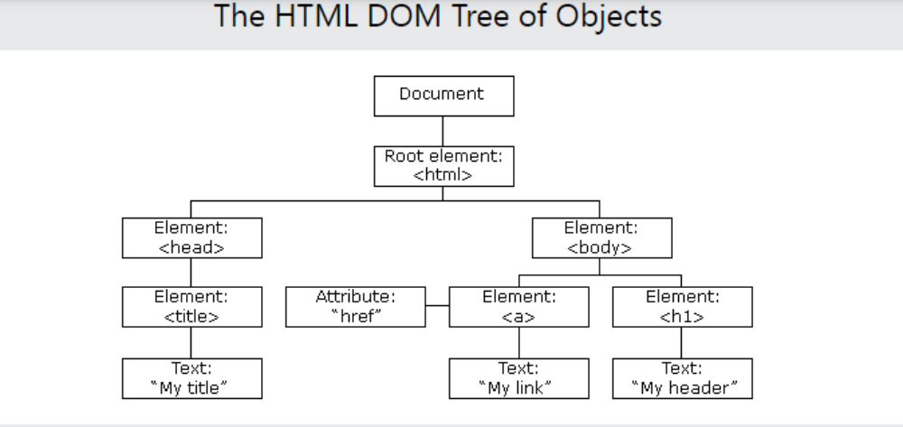
With the HTML DOM, JavaScript can access and change all the elements of an HTML document.
When a web page is loaded, the browser creates a Document Object Model of the page.
The HTML DOM model is constructed as a tree of Objects:

Slide 14
With the object model, JavaScript gets all the power it needs to create dynamic HTML:
JavaScript can change all the HTML elements in the page
JavaScript can change all the HTML attributes in the page
JavaScript can change all the CSS styles in the page
JavaScript can remove existing HTML elements and attributes
JavaScript can add new HTML elements and attributes
JavaScript can react to all existing HTML events in the page
JavaScript can create new HTML events in the page

Slide 15
An applet is a Java program that runs in a Web browser. Java applets are downloaded separately from the HTML documents that call them;
Java applets are used to provide interactive features to web applications and can be executed by browsers for many platforms.
They are small, portable Java programs embedded in HTML pages and can run automatically when the pages are viewed.
Many Java Scripts, however, are an integral part of the HTML document, so no secondary downloading is necessary.
Java Script can be used as an alternative to Java applets.
https://www.learnacademy.org/blog/javascript-used-for/
https://itstillworks.com/difference-between-java-applet-javascript-6400316.html

Slide 16
Event driven computation…
One of the common uses of Java Scripts is to check the values provided in forms by users to determine whether the values are sensible
Without client side checks of such values, form values must be transmitted to the server for processing without any prior reality checks
It is more efficient to perform input data checks and carry on this user dialog entirely on the client
It saves both server time and internet time

Slide 17
Browsers and HTML/Java Script Documents
When a JavaScript script is encountered in the document, the browser uses its Java Script interpreter to execute the script.
When the end of the script is reached, the browser goes back to reading the HTML document and displaying its content.
Scripts that produce content only when requested or that react to user interactions are placed in the head of the HTML document.
On the other hand, scripts that are to be interpreted just once, when the interpreter finds them, are placed in the HTML document body.

Slide 18
Object orientation and Java Script…
Java Script is not an object-oriented programming language; rather its an object-based language.
Java Script doesn’t have classes.
Without classes, Java Script cannot have class based inheritance.
Without class-based inheritance, Java Script cannot support polymorphism.

Slide 19
In JavaScript, almost "everything" is an object.
Booleans can be objects (if defined with the new keyword)
Numbers can be objects (if defined with the new keyword)
Strings can be objects (if defined with the new keyword)
Dates are always objects
Maths are always objects
Regular expressions are always objects
Arrays are always objects
Functions are always objects
Objects are always objects
All JavaScript values, except primitives, are objects.

Slide 20
Java Script objects serve both as objects and as models of objects.
A JavaScript object is a collection of unordered properties.
In Java Script, objects are collections of properties, which correspond to the members of classes in Java and C++.

Slide 21
Each property is either a data property or a method property.
Data properties appear in 2 categories: primitive values and reference to other objects.
Java Script uses non-object types for some of its simplest data types; these types are called primitives.
Primitives are like the simple scalar variables of non-object-oriented languages such as C.
Everything that are not primitive types are objects in Java Script.

Slide 22
4 main differences between primitive types and objects in Java Script are:
1. Primitive types are immutable. We cant change value of a primitive type, we can only assign a new value to variables.
whereas Objects can change values because they hold properties,
using which values can be modified.
2. Primitives are passed by value, Objects are passed by reference.
3.Primitives are copied by value, objects are copied by reference.
4. Primitive types are compared by value. Objects are compared by reference

Slide 23
var name = ‘Flavia’
var secondname = name
name = ‘Roger’
secondname
//Output will be Roger for name and Flavia for secondname it does not change as Roger, coz primitives have pass by value
-------------------------------------------------------------------------------------
var car= { color:’yellow’}
var secondcar=car
Now if we modify
car.color=‘blue’
secondcar.color
// Output will be blue for both , coz car and secondcar both point to same object.

Slide 24
JavaScript Primitives
A primitive value is a value that has no properties or methods.
A primitive data type is data that has a primitive value.
JavaScript defines 5 types of primitive data types:
string
number
boolean
null
undefined
Primitive values are immutable (they are hardcoded and therefore cannot be changed).

Slide 25
In JavaScript, an object is a standalone entity, with properties and type.
Compare it with a cup, for example. A cup is an object, with properties.
A cup has a color, a design, weight, a material it is made of, etc.
The same way, JavaScript objects can have properties, which define their characteristics.

Slide 26
A JavaScript object has properties associated with it.
A property of an object can be explained as a variable that is attached to the object.
Object properties are basically the same as ordinary JavaScript variables, except for the attachment to objects.
The properties of an object define the characteristics of the object.
You access the properties of an object with a simple dot-notation:
objectName.propertyName

Slide 27
The root object in Java Script is Object.
Object is the most generic of all objects, having some methods but no properties.
All other objects are specializations of Object, and all inherit its methods.
A Java Script object appears, both internally and externally, as a list of property/value pairs.
The properties are names; the values are data values or functions.

Slide 28
General syntactic characteristics…
Scripts can appear directly as the content of a <script> tag.
The type attribute of <script> must be set to “text/javascript”
Example:
<script type=“text/javascript” src=“tst_number.js”/>

Slide 29
Identifiers, or names in Java Script are similar to those of other common programming languages.
They must begin with a letter, an underscore _ or a dollar ($) sign; Subsequent characters may be letters, underscores, dollar signs or digits.
There is no length limitation for identifiers.
The letters in a variable name are case sensitive.

Slide 30
Reserved words of Java Script..
break | delete | function | return | typeof
case | do | if | switch | var
catch | else | in | this | void
continue | finally | instanceof | throw | while
default | for | new | try | with

Slide 31
Java Script has 2 forms of comments, both of which are used other languages /* and //
Java Script code is written with HTML comments as :
When Java Script was first released, a technique was needed to hide the code from older browsers so they wouldn't show it as text in the page. The 'hack' was to use HTML comments within the script block to hide the code.
<!--
-- JavaScript script –
// -->

Slide 32
JavaScript does not strictly require semicolons. When there is a place where a semicolon is needed, it adds it behind the scenes.
This is called Automatic Semicolon Insertion.
The Java Script interpreter tries to make semicolons unnecessary, but it does not always work.
When the end of a line coincides with what could be the end of a statement, the interpreter effectively inserts a semicolon there.
But this can lead to a problem
Example:
return
x;
The interpreter puts a semicolon after return, making x an illegal operation.

Slide 33
Primitives, Operations and Expressions…
Datatypes hold different values. There are two types of datatypes in JavaScript: Primitive and Non-Primitive. Primitive defines immutable values, non-primitive are mutable.
Primitive Types:
Java Script has five primitive types:
Number, String, Boolean, Undefined and Null
Primitive is a data in Java Script is not an object and has no methods.

Slide 34
Number, String, Boolean – these 3 are three primitive wrapper types.
Their purpose is to provide properties and methods that are convenient for use with values of the primitive types.
When you interact with a primitive value like it was an object (by calling a method or reading a property from it), JavaScript creates a wrapper object on the fly.
You have read access to properties and methods of wrapper objects, like they were regular objects.
A wrapper object is disposed right after a single use.
Each primitive type has a counterpart type for its wrapper objects. These types are String, Number and Boolean.
It’s possible to instantiate a wrapper object explicitly, by using its constructor. However, it’s rarely necessary (if at all). Normally, the better approach is to use regular objects instead.

Slide 35
Numeric and String Literals:
All numeric literals are values of type Number.
The Numeric values of Java Script are represented internally in double-precision floating point form.
Examples:
72 7.2 .72 72. 7E2 7e2 .7e2 7.e2
7.2E-2
Integer literals can be written in hexadecimal form by preceding their first digit with either 0x 0r 0X.

Slide 36
Other Primitive Types:
The only value of type Boolean are true and false.
The only value of type Null is the reserved word null which indicates no value.
The only value of type Undefined is undefined.
If a variable does not exist or has been declared but not assigned a value, it has the value undefined.

Slide 37
Declaring Variables:
A variable can be used for anything. It can have the value of any primitive type or it can be a reference to any object.
Declaration begins with a reserved word var
Example:
var counter, index, pi=3.14159,
st=“hello”, stop_flag=true;
Variables can be declared and initialize without the var keyword.
However, a value must be assigned to a variable declared without the var keyword.
The variables declared without the var keyword becomes global variables, irrespective of where they are declared.

Slide 38
Numeric Operators:
+, -, *, /, % - binary operators
Negate(-), decrement (--), increment(++)
Assignment statement:
Assignment operator denoted by =

Slide 39
Math Object:
The JavaScript Math object allows you to perform mathematical tasks on numbers.
JavaScript provides 8 mathematical constants that can be accessed as Math properties:
Math.E // returns Euler's number
Math.PI // returns PI
Math.SQRT2 // returns the square root of 2
Math.SQRT1_2 // returns the square root of 1/2
Math.LN2 // returns the natural logarithm of 2
Math.LN10 // returns the natural logarithm of 10
Math.LOG2E // returns base 2 logarithm of E
Math.LOG10E // returns base 10 logarithm of E

Slide 40
Math Methods:
The syntax for Math any methods is
Math.method(number)
sin, cos, floor (to truncate), round (rounding), max (max of 2 nos)
Example:
Math.sin(x)

Slide 41
Number to Integer:
There are 4 common methods to round a number to an integer:
Math.round(x) | Returns x rounded to its nearest integer
Math.ceil(x) | Returns x rounded up to its nearest integer
Math.floor(x) | Returns x rounded down to its nearest integer
Math.trunc(x) | Returns the integer part of x
Math.round(4.9); // returns 5
Math.round(4.7); // returns 5
Math.round(4.4); // returns 4
Math.round(4.2); // returns 4
Math.round(-4.2); // returns -4

Slide 42
Math.ceil()
Math.ceil(x) returns the value of x rounded up to its nearest integer:
Math.ceil(4.9); // returns 5
Math.ceil(4.7); // returns 5
Math.ceil(4.4); // returns 5
Math.ceil(4.2); // returns 5
Math.ceil(-4.2); // returns -4
Math.floor()
Math.floor(x) returns the value of x rounded down to its nearest integer:
Math.floor(4.9); // returns 4
Math.floor(4.7); // returns 4
Math.floor(4.4); // returns 4
Math.floor(4.2); // returns 4
Math.floor(-4.2); // returns -5

Slide 43
Math.trunc()
Math.trunc(x) returns the integer part of x:
Math.trunc(4.9); // returns 4
Math.trunc(4.7); // returns 4
Math.trunc(4.4); // returns 4
Math.trunc(4.2); // returns 4
Math.trunc(-4.2); // returns -4
Math.sign()
Math.sign(x) returns if x is negative, null or positive:
Math.sign(-4); // returns -1
Math.sign(0); // returns 0
Math.sign(4); // returns 1

Slide 44
The Number Object:
The Number object includes a collection of useful properties that have constant values.
These properties are referred through Number.
The Number object represents numerical data, either integers or floating-point numbers.
With JavaScript, methods and properties are also available to primitive values, because JavaScript treats primitive values as objects when executing methods and properties.
Example:
Number.MIN_VALUE

Slide 45
The syntax for creating a number object is as follows −
var val = new Number(number);
In the place of number, if you provide any non-number argument, then the argument cannot be converted into a number, it returns NaN (Not-a-Number).

Slide 46
Properties of Number…
Property | Meaning
MAX_VALUE | Largest representable no
MIN_VALUE | Smallest representable no
NaN | Not a number
POSITIVE_INFINITY | Special value to represent infinity
NEGATIVE_INFINITY | Special value to represent negative infinity
PI | The value of PIE

Slide 47
1 | MAX_VALUE The largest possible value a number in JavaScript can have 1.7976931348623157E+308
2 | MIN_VALUE The smallest possible value a number in JavaScript can have 5E-324
3 | NaN Equal to a value that is not a number.
4 | NEGATIVE_INFINITY A value that is less than MIN_VALUE.
5 | POSITIVE_INFINITY A value that is greater than MAX_VALUE

Slide 48
Number Methods
The Number object contains only the default methods that are a part of every object's definition.
 | Method & Description
1 | toExponential() Forces a number to display in exponential notation, even if the number is in the range in which JavaScript normally uses standard notation.
2 | toFixed() Formats a number with a specific number of digits to the right of the decimal.
3 | toLocaleString() Returns a string value version of the current number in a format that may vary according to a browser's local settings.
4 | toPrecision() Defines how many total digits (including digits to the left and right of the decimal) to display of a number.
5 | toString() Returns the string representation of the number's value.
6 | valueOf() Returns the number's value.

Slide 49
<html>
<head>
<title>JavaScript toString() Method </title>
</head>
<body>
<script type = "text/javascript"> var num = new Number(15); document.write("num.toString() is " + num.toString()); document.write("<br />"); document.write("num.toString(2) is " + num.toString(2)); document.write("<br />"); document.write("num.toString(4) is " + num.toString(4)); document.write("<br />");
</script>
</body>
</html>

Slide 50
Output num.toString() is 15 num.toString(2) is 1111 num.toString(4) is 33
<html>
<head>
<title>JavaScript valueOf() Method </title>
</head>
<body>
<script type = "text/javascript"> var num = new Number(15.11234); document.write("num.valueOf() is " + num.valueOf());
</script>
</body>
</html>
Output num.valueOf() is 15.11234

Slide 51
The toString() Method:
The toString() method returns a number as a string.
All number methods can be used on any type of numbers (literals, variables, or expressions):
let x = 123;
x.toString(); // returns 123 from variable x
(123).toString(); // returns 123 from literal 123
(100 + 23).toString(); // returns 123 from expression 100 + 23

Slide 52
To determine whether a variable has the NaN value, the pre-defined predicate function isNaN() must be used.
For example, if the variable a has NaN value, isNaN(a) returns true.
The Number object has a method, toString, converts number through which it is called to a string.
Example:
var price=427, str_price;
…
str_price = price.toString();

Slide 53
Check whether a value is NaN:
isNaN(123) //false
isNaN(-1.23) //false
isNaN(5-2) //false
isNaN(0) //false
isNaN('123') //false
isNaN('Hello') //true
isNaN('2005/12/12') //true
isNaN('') //false
This function returns true if the value equates to NaN. Otherwise it returns false.
The global isNaN() function, converts the tested value to a Number, then tests it.
Number.isNaN() does not convert the values to a Number, and will not return true for any value that is not of the type Number.

Slide 54
The String Catenation Operator:
String catenation is specified with the operator denoted by a plus sign (+).
Example:
If the value of variable first is “Freddie”, the value of the expression:
first + “ Freeloader” is “Freddie Freeloader”

Slide 55
Implicit Type Conversions:
The Java Script interpreter performs several different implicit type conversions
Such conversions are called coercions
Example:
1) Input: "2" + "3"
Output: "23"
here + operator stands for string concatenation in this case.
2) But "3" - "1" gives output 2 by using Implicit Conversion.
3) “August ” + 1977
Here right operand is implicitly converted to a
String.
4) 7 *”3”
here the right operand is converted to number

Slide 56
<script>
document.write('("3" - "1") = ' + ("3" - "1") + "<br>");
document.write('("3" - 1) = ' + ("3" - 1) + "<br>");
document.write('("3" * "2") = ' + ("3" * "2") + "<br>");
document.write('("3" % "2") = ' + ("3" % "2") + "<br>");
document.write('("3" + null) = ' + ("3" + null) + "<br>");
</script>
Output:
("3" - "1") = 2
("3" - 1) = 2
("3" * "2") = 6
("3" % "2") = 1
("3" + null) = 3null

Slide 57
Explicit type conversions:
Converting Values to Strings:
String() or toString() function can be used in JavaScript to convert a value to a string.
Input: var v = 1555;
var s = String(v);
Output: now s contains "1555".
Input: var v = 1555;
var s = v.toString();
Output: now s contains "1555".

Slide 58
Converting Values to Numbers:
We can use Number() function in JavaScript to convert a value to a Number.
It can convert any numerical text and boolean value to a Number.
In case of strings of non-numbers it will convert it to a NaN(Not a Number).
Input: var s = "144";
var n = Number(s);
Output: now n contain 144(Number).

Slide 59
<script>
var v = "144";
// Conversion of string to number
document.write(" Number(v) = " + Number(v) + "<br>");
//Conversion of boolean value to number
document.write(" Number(false) = " + Number(false) + "<br>");
document.write(" Number(true) = " + Number(true) + "<br>");
</script>
Output:
Number(v) = 144
Number(false) = 0
Number(true) = 1

Slide 60
<script>
// Empty string assigned
var v = "";
// White space assigned
var d = " ";
// Non-number string assigned
var s = "GeeksforGeeks";
// Printing converted values of number
document.write(" Number(v) = " + Number(v) + "<br>");
document.write(" Number(d) = " + Number(d) + "<br>");
document.write(" Number(s) = " + Number(s) + "<br>");
</script>
Output:
Number(v) = 0
Number(d) = 0
Number(s) = NaN

Slide 61
parseInt is for converting a non integer number to an int and parseFloat is for converting a non float (with out a decimal) to a float (with a decimal).
The parseInt function searches the string for an integer literal.
If one is found at the beginning of the string, it is converted into a number and returned;
Similarly parseFloat.

Slide 62
String Properties and Methods:
The String object lets you work with a series of characters; it wraps Javascript's string primitive data type with a number of helper methods.
As JavaScript automatically converts between string primitives and String objects, you can call any of the helper methods of the String object on a string primitive.
Following syntax to create a String object −
var val = new String(string);

Slide 63
The String object includes one property, length, and a large collection of methods.
Example:
var str=“George”
var len=str.length

Slide 64
Method | Parameters | Result
charAt | A number | Char at specified position
indexOf | One-character string | Position in the string
substring | 2 nos | substring from first parameter position to the second
toLowerCase | none | Converts any uppercase letters in the string to lowercase
toUpperCase | none | Converts any lowercase letters in the string to uppercase

Slide 65
Example:
var str=“George”
str.charAt(2) is ‘o’ (Returns character at specified index)
str.indexOf(‘r’) is 3 (Returns the index within the calling String object of the first occurrence of the specified value, or -1 if not found)
str.substring(2, 4) is ‘org’ (Returns the characters in a string between two indexes into the string)
str.toLowerCase() is ‘george’
For more on methods:
https://www.tutorialspoint.com/javascript/javascript_strings_object.htm

Slide 66
<html>
<head>
<title>JavaScript String charAt() Method</title>
</head>
<body>
<script type = "text/javascript">
var str = new String( "This is string" );
document.writeln("str.charAt(0) is:" + str.charAt(0)); document.writeln("<br />str.charAt(1) is:" + str.charAt(1)); document.writeln("<br />str.charAt(2) is:" + str.charAt(2)); document.writeln("<br />str.charAt(3) is:" + str.charAt(3)); document.writeln("<br />str.charAt(4) is:" + str.charAt(4)); document.writeln("<br />str.charAt(5) is:" + str.charAt(5));
</script>
</body>
</html>

Slide 67
Output
str.charAt(0) is:T
str.charAt(1) is:h
str.charAt(2) is:i
str.charAt(3) is:s
str.charAt(4) is:
str.charAt(5) is:i

Slide 68
<html>
<head>
<title>JavaScript String lastIndexOf() Method</title>
</head>
<body>
<script type = "text/javascript">
var str1 = new String( "This is string one and again string" );
var index = str1.lastIndexOf( "string" );
document.write("lastIndexOf found String :" + index ); document.write("<br />");
var index = str1.lastIndexOf( "one" );
document.write("lastIndexOf found String :" + index );
</script>
</body>
</html>
Output
lastIndexOf found String :29 lastIndexOf found String :15

Slide 69
The ‘typeof’ operator…
Returns the type of its single operand
typeof evaluates to “number”, “string”, or “boolean” if the operand is of primitive type number, string or boolean respectively and true or false based on the evaluation.
If the operand is an object or null, typeof evaluates to “object”

Slide 70
If the operand is undefined, typeof evaluates to the string “undefined”
Example:
typeof x or typeof(x)
typeof "John" // Returns "string"
typeof 3.14 // Returns "number"
typeof NaN // Returns "number"
typeof false // Returns "boolean"
typeof [1,2,3,4] // Returns "object"
typeof {name:'John', age:34} // Returns "object"
typeof new Date() // Returns "object"
typeof function () {} // Returns "function"
typeof null // Returns "object"

Slide 71
The Date object…
A Date object is created with the new operator and the Date constructor
Example:
var today = new Date( );

Slide 72
Method | Returns
toLocaleString | A string of Date information
getDate | The Day of the month
getMonth | Month of the year
getDay | Day of a week
getFullYear | The year
getTime | No in milliseconds since Jan 1 1970
getHours | No of hours (as a no between 0-23)
getMinutes | No of minutes (0-59)
getSeconds | No of seconds (0-59)
getMilliseconds | No of ms (0 – 999)

Slide 73
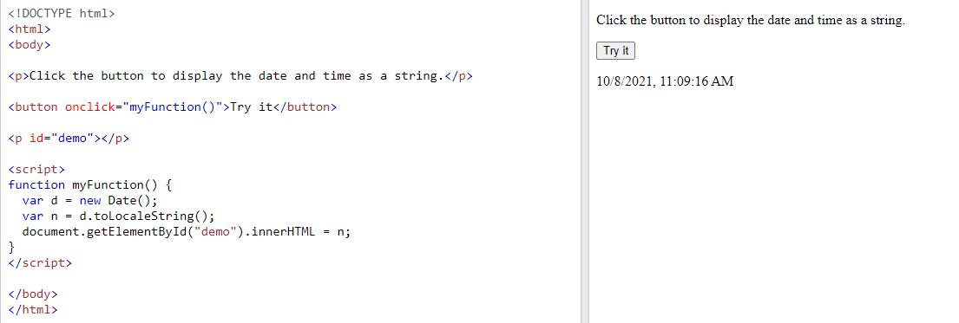
// Returns the day of the month (from 1-31):
var d = new Date();
var n = d.getDate();

Slide 74
Control Statements…
Control Expressions:
The result of evaluating a control expression is one of the Boolean values true or false
Relational Operators:
==, !=, <, >, <=, >=, === (is strictly equal to, considers operands of different type to be different),
!== (is strictly not equal to)
Last 2 operators disallow type conversion of either operand
Example:
The expression “3”===3 evaluates to false where as
“3”==3 evaluates to true

Slide 75
In JavaScript. == is used for comparison between two variables irrespective of the datatype of variable.
=== is used for comparision between two variables but this will check strict type, which means it will check datatype and compare two values.
If a and b reference different objects, a==b is never true, even if the objects have identical properties
a==b is true if a and b reference the same object
Javascript also uses operators AND (&&), OR (||) and NOT (!) boolean operations

Slide 76
Selection Statements:
The selection statements (if-then and if-then-else) are similar to those of the common programming languages
Example:
if (a>b)
document.write (“a > b <br />”);
else
document.write (“a not greater than b <br />”);

Slide 77
The switch statement:
switch (expression)
{
case value_1:
// statement(s)
break;
case value_2:
// statement(s)
break;
…
default:
// statement(s)
}

Slide 78
JavaScript supports different kinds of loops:
for - loops through a block of code a number of times
for/in - loops through the properties of an object
while - loops through a block of code while a specified condition is true
do/while - loops through a block of code once, and then repeats the loop while a specified condition is true

Slide 79
Loop Statements…
while (control expression)
statement or compound statement
for (initial expression; control expression; increment expression)
statement or compound statement
do
statement or compound statement
while (control expression);

Slide 80
Java Script has a loop statement, for-in, that is perfect for listing the properties of an object
The form of for-in is as follows:
for (identifier in object)
statement or compound statement

Slide 81
Screen Output and Keyboard Input…
Every web page resides inside a browser window which can be considered as an object.
A Document object represents the HTML document that is displayed in that window.
Normal output screen for Java Script is the same as the screen in which the content of the host HTML is displayed
The window in which the browser displays an HTML document is modeled with the Window object.

Slide 82
An object of window is created automatically by the browser. Window is the object of browser, it is not the object of javascript.
JavaScript Document object is an object that provides access to all HTML elements of a document.
When an HTML document is loaded into a browser window, then it becomes a document object.
The Document object has various properties that refer to other objects which allow access to and modification of document content.
The way a document content is accessed and modified is called the Document Object Model, or DOM.

Slide 83
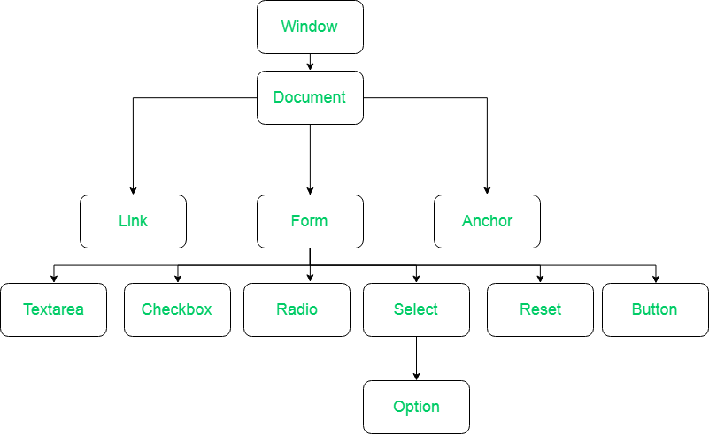

Slide 84
The JavaScript model for the HTML document is the Document object.
The model for the browser display window is the Window object
The Window object includes 2 properties, document and window, which refer to the document and window objects, respectively
The document property refers to the Document object
The window property is self referential; i.e. it refers to the object Window

Slide 85
The most interesting and useful of Document object method is write,
The Document object has a method, write, which dynamically creates content
Example:
document.write(“the result is: “ + result, “<br />”);
The parameter is a string, often catenated from parts, some of which are variables
The writeln method implicitly adds “\n” to its parameters, but since browsers ignore line breaks when displaying HTML, is has no effect on the output.

Slide 86
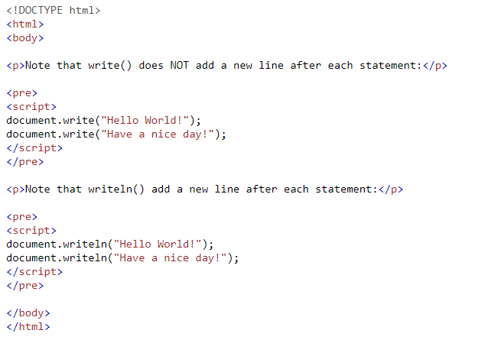


Slide 87
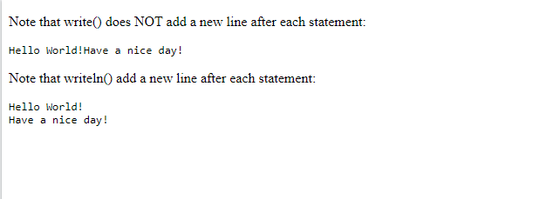

Slide 88
The Window object has three methods for creating dialog boxes, alert, confirm, and prompt.
The default object for JavaScript is the Window object currently being displayed, so calls to these methods need not include an object reference.
The alert method opens a dialog window and displays its parameter in that window
Example:
alert (“The sum is: “ +sum+ “\n”);
Parameter is plain text, not HTML
Opens a dialog box which displays the parameter string and an OK button

Slide 89
<html>
<head>
<script type = "text/javascript">
<!-- function showValue()
{
var val = Number.MIN_VALUE;
alert("Value of Number.MIN_VALUE : " + val ); } //-->
</script>
</head>
<body>
<p>Click the following to see the result:</p>
<form>
<input type = "button" value = "Click Me" onclick = "showValue();" /> </form>
</body>
</html>

Slide 90
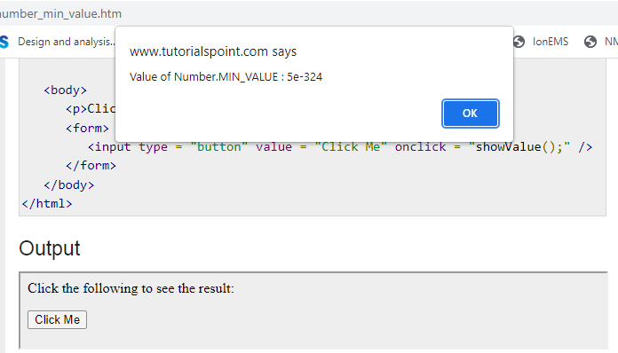

Slide 91
The confirm method opens a dialog window in which it displays its string parameter, along with 2 buttons, OK and Cancel
confirm returns a Boolean value that indicates the user’s button input: true for OK and false for Cancel
Example:
var question = confirm (“Do you want to continue this download?”);

Slide 92
The prompt method creates a dialog window that contains a text box
The text box is used to collect a string of input from the user, which prompt returns as its value
The window also includes OK and Cancel button.
Prompt takes 2 parameters: the string that prompts the user for input and a default string in case the user does not type a string before pressing one of the 2 buttons
Example:
Name = prompt (“What is your name?”, “ ”);

Slide 93
Example 1…
<html> <head> <title> Real roots of a quadratic equation </title>
</head>
<body>
<script type="text/javascript">
<!--
var a = prompt ("What is the value of 'a'?\n","");
var b = prompt ("What is the value of 'b'?\n","");
var c = prompt ("What is the value of 'c'?\n","");
var root_part = Math.sqrt(b*b - 4.0*a*c);
var denom = 2.0 * a;
var root1 = (-b + root_part) / denom;
var root2 = (-b - root_part) / denom;

Slide 94
var result=confirm ("Want to continue??");
if(result==true)
alert("You clicked on OK button");
else
alert("You clicked on Cancel button");
document.write("The first root is: ", root1, "<br />");
document.write("The second root is: ", root2, "<br />");
// -->
</script>
</body>
</html>

Slide 95
Example 2
<html> <head> <title> example </title>
</head>
<body>
<script type="text/javascript">
<!--
var bordersize;
bordersize = prompt ("Select border size\n","5");
var st = "<table border= " + bordersize + ">";
alert(st);
document.write(st);
document.write("<caption> table1 </caption>");

Slide 96
document.write("<tr>",
"<th>s </th>",
"<th> Heading 1 </th>",
"<th> Heading 2 </th>",
"</tr>",
"<tr>",
"<th> Row1 </th>",
"<td> r1, c1 </td>",
"<td> r1, c2 </td>",
"</tr>",
"<th> Row2 </th>",
"<td> r2, c1 </td>",
"<td> r2, c2 </td>",
"</tr>",
"</table>");
// -->
</script> </body> </html>

Slide 97
Create a webpage with JavaScript to ask user entering width and length of a rectangle. Take the user's answers and display the area and perimeter of the rectangle.

Slide 98
Object Creation and Modification…
Objects are often created with a new expression, which must include a call to a constructor method
The following statement creates an object that
initially has no properties:
var my_object = new Object( );
The variable my_object reference the new object

Slide 99
The properties of an object are accessed using dot notation, in which the first word is the object name and the second is the property name
A property for an object is created by assigning a value to that property
Example:
//create an Object object
var my_car = new Object( );
//create and initialize the make property
my_car.make =“Ford”;
//create and initialize the model property
my_car.model = “Contour SVT”;

Slide 100
Objects can be nested
Example:
my_car.engine = new Object ( );
my_car.engine.config = “v6”;
my_car.engine.hp = 200;
There are 2 methods to access the property values: using object-dot-property notation or using the property name
Example:
var prop1 = my_car.make;
var prop2 = my_car [“make”]

Slide 101
A property can be deleted with delete, as in the following example:
delete my_car.model;
Accessing the values:
for (var prop in my_car)
document.write (“Name: “, prop, “; Value: “,
my_car[prop], “<br />);
The variable, prop, takes on the values of the properties of the my_car object, one for each iteration

Slide 102
Constructors…
A constructor must be able to reference the object on which it is to operate
JavaScript has a predefined reference variable for this purpose, named this
Example:
function car(new_make, new_model, new_year)
{
this.make = new_make;
this.model = new_model;
this.year = new_year;
}
This constructor could be used as in the following:
my_car = new car (“Ford”, “Contour SVT”, “2000”);

Slide 103
We can define the method for the object also
Example:
function display_car ( )
{
document.write (“ Car Make:”, this.make,“<br/>”);
document.write (“ Car Model:”,this.model,“<br/>”);
document.write (“ Car Year:”, this.year,“<br/>”);
}
The following line must be added to the car constructor:
this.display = display_car;

Slide 104
Now, the code my_car.display(); would produce the following:
Car Make: Ford
Car Model: Contour SVT
Car Year: 2000

Slide 105
Arrays…
Array object creation:
Can be created in 2 distinct ways
First method is using new operator and constructor
Example:
var my_list = new Array (1, 2, “three”, “four”);
var your_list = new Array (100);

Slide 106
Second way to create an Array object is with a literal array value, which is a list of values enclosed in brackets
Example:
var my_list = [1, 2, “three”, “four”];

Slide 107
Characteristics of Array Objects:
Lowest index of every Java Script array is zero
The length of an array is both read and write accessible through the length property
Assigning a value to the length property can lengthen, shorten or not affect the array’s length
Example:
my_list.length = 100;
Now, the length of my_list is 100

Slide 108
Array Methods:
The join method converts all of the elements of an array to strings and concatenates them into a single string
If no parameter is provided to join, the values in the new string are separated by commas
Example:
var names = new Array ( “Ajay”, “Ravi”, “Roopa”);
…
var name_string = names.join (“ : ”);
The values of name_string is now “Ajay : Ravi : Roopa”

Slide 109
The reverse method reverses the order of the
elements of the Array object
var fruits = ["Banana", "Orange", "Apple", "Mango"];
fruits.reverse(); // Mango,Apple,Orange,Banana
The sort method sorts the Array object in alphabetical order
var fruits = ["Banana", "Orange", "Apple", "Mango"];
fruits.sort(); // Apple,Banana,Mango,Orange

Slide 110
The concat method concatenates its actual parameters to the end of the Array object on which it is called
Example:
var names = new Array [“Ajay”, ”Ravi”];
…
var new_names = names.concat (“Amar”, “Raj”);
Now new_names consists of “Ajay”, ”Ravi”, “Amar”, “Raj”

Slide 111
The slice method returns the part of the Array object specified by its parameters, which are used as subscripts
The returned array has the elements of the array object through which it is called from the first parameter up to but not including the second parameter
var fruits = ["Banana", "Orange", "Lemon", "Apple", "Mango"];
var citrus = fruits.slice(1, 3); // Orange,Lemon

Slide 112
Example:
var list = [2, 4, 6, 8, 10];
…
var list2 = list.slice (1, 3);
The value of list2 is now [4, 6]
If slice is given just one parameter, the returned array has all of the elements of the object, starting with the specified index

Slide 113
The toString method is used convert the array elements of the object to a string
These strings are concatenated, separated by commas
var fruits = ["Banana", "Orange", "Apple", "Mango"];
fruits.toString(); // Banana,Orange,Apple,Mango
The pop and push methods remove and add an element to the high end of an array
Example:
var list=[“Amar”, “Raj”, “Kiran”, “Kumar”];
var name = list.pop(); //name is “Kumar”
list.push (“Kumar”); //puts back “Kumar”

Slide 114
The shift and unshift methods remove and add an element to the beginning of an array, respectively
var fruits = ["Banana", "Orange", "Apple", "Mango"];
fruits.shift(); // Orange,Apple,Mango
var fruits = ["Banana", "Orange", "Apple", "Mango"];
fruits.unshift("Lemon", "Pineapple");
// Lemon,Pineapple,Banana,Orange,Apple,Mango
A two-dimensional array is implemented in Java Script as an array of arrays
Example:
var mat1 = [ [2, 4, 6],
[1, 3, 5],
[10, 20, 30]
];

Slide 115
1. Write a simple JavaScript program to join all elements of the following array into a string.
Sample array : myColor = ["Red", "Green", "White", "Black"];
Expected Output :
"Red,Green,White,Black"
"Red,Green,White,Black"
"Red+Green+White+Black”
2. Write a JavaScript program to sort the items of an array.
Sample array : var arr1 = [ 3, 8, 7, 6, 5, -4, -3, 2, 1 ];
Sample Output : -4,-3,1,2,3,5,6,7,8
3. Write a JavaScript program to compute the sum and product of an array of integers.
Refer for more programs: https://www.w3resource.com/javascript-exercises/javascript-array-exercises.php

Slide 116
Prg1:
myColor = ["Red", "Green", "White", "Black"];
document.write(myColor.toString());
document.write(myColor.join());
document.write(myColor.join('+'));
Prg3:
var array = [1, 2, 3, 4, 5, 6], s = 0, p = 1, i;
for (i = 0; i < array.length; i += 1)
{
s += array[i];
p *= array[i];
}
document.write('Sum : '+s + ' Product : ' +p);

Slide 117
Functions…
Function Call:
fun1( );
result=fun2( );
Function Definition:
function function_name ( parameters )
{
…
}

Slide 118
Function definitions are placed in the head of an HTML document
Calls to functions normally, but not always, appear in the document body
Variables that are explicitly declared outside the function definitions have global scope
Any variable explicitly declared with var in the body of a function has local scope

Slide 119
The parameter values that appear in a call to a function are called Actual Parameters
The parameter names that appear in the header of a function definition, which corresponds to the actual parameters in calls to the function, are called Formal parameters
The no of parameters in a function call is not checked against the number of formal parameters in the called function

Slide 120
In the function, excess Actual parameters that are passed are ignored
Excess formal parameters are set to undefined
All parameters are communicated through a property array, arguments, has a property named length
The arguments.length property contains the number of arguments passed to the function.
By accessing arguments.length, a function can determine the no of actual parameters that were passed

Slide 121
Example 1
<html> <head> <title> example </title>
<script type="text/javascript">
<!--
function fun_1(a, b)
{
document.write(" Function fun_1 was passed ", arguments.length, " parameters <br />");
document.write("Parameter Values are: <br />");
for(var arg=0; arg<arguments.length; arg++)
{
document.write(arguments[arg], "<br />");
}
document.write("<br />");
}
// -->
</script>
</head>

Slide 122
<body>
<script type="text/javascript">
<!--
fun_1("Hello");
fun_1("Hello", "Hi", 1997);
fun_1(100, 200, "Hello", 23.6);
// -->
</script>
</body>
</html>

Slide 123
<html> <head> <title> example </title>
<script type="text/javascript">
<!--
function first_vowel(str)
{
for (var i=0; i<str.length;i++)
{
if(str.charAt(i)=="a" || str.charAt(i)=="e" || str.charAt(i)=="i" || str.charAt(i)=="o" ||str.charAt(i)=="u")
return i;
}
return -1;
}
// -->
</script>
</head>
Example 2

Slide 124
<body>
<script type="text/javascript">
<!--
var s = prompt ("Enter the string \n","");
var val = first_vowel(s);
if(val == -1)
document.write ("No vowel in the given string <br />");
else
document.write ("First Vowel found at position ", val, " <br />");
// -->
</script>
</body>
</html>

Slide 125
Pattern Matching using Regular Expressions
A regular expression is a sequence of characters that forms a search pattern.
When you search for data in a text, you can use this search pattern to describe what you are searching for.
A regular expression can be a single character, or a more complicated pattern.
Regular expressions can be used to perform all types of text search and text replace operations.
There are 2 approaches to pattern matching in Java Script:
  One based on RegExp object
  Another based on methods of the String method

Slide 126
We discuss only the String method
Patterns are specified in a form that is based on regular expressions
Patterns, which are sent as parameters to the pattern-matching methods, are delimited with slashes
In JavaScript, regular expressions are often used with the two string methods: search() and replace().
The search() method uses an expression to search for a match, and returns the position of the match.
The replace() method returns a modified string where the pattern is replaced.

Slide 127
Character & Character Class Patterns:
The meta characters are:
\ | ( ) [ ] { } ^ $ * + ? .
The simplest pattern matching method is search which takes a pattern as a parameter
Returns the position in the string object where the pattern matched else returns -1
Example:
var str = “Rabbits are furry”;
var pos = str.search (/bits/);

Slide 128
A period . matches any character except new line
Example:
/snow./ matches “snowy”, “snowe” etc
To match a period in a string, the pattern must backslash the period
Example:
/3\.4/ matches 3.4

Slide 129
Character class is specified within [ ]
Example:
[abc] matches either a or b or c
Also we have: [a-h] and [^aeiou]

Slide 130
Predefined Character Classes…
Name | Equivalent pattern | Matches
\d | [0-9] | A digit
\D | [^0-9] | Not a digit
\w | [A-Za-z_0-9] | A word character
\W | [^ A-Za-z_0-9] | Not a word char
\s | [ \r\t\n\f] | A whitespace char
\S | [^ \r\t\n\f] | Not whitespace char

Slide 131
Example:
/\d\.\d\d/ Matches a digit, followed by a period, followed by 2 digits
/\D\d\D/ Matches a single digit
/\w\w\w/ Matches three adjacent word characters
To repeat a pattern, a numeric, quantifier, delimited by braces, is attached
Example:
/xy{4}z/ matches xyyyyz

Slide 132
* Means zero or more repetitions
+ Means one or more repetitions
? Means one or none
Examples:
/x*y+z?/
/\d+\.\d*/
/[A-Za-z]\w*/

Slide 133
\b (boundary) matches the boundary position between a word character (\w) and a non-word character (\W), in either order
Example:
/\bis\b/ matches “A tulip is a flower” but doesn’t match to “A frog isn’t”

Slide 134
Anchors:
It is frequently useful to be able to specify that a pattern must match at a particular position in the string
A pattern is tied to a string position with a an anchor
A pattern can be specified to match only at the beginning of the string by preceding it with circumflex (^) anchor
Example:
/^pearl/ Matches “pearls are pretty” but doesn’t match “My pearls are pretty”

Slide 135
A pattern can be specified to match only at the end of a string by following it with a dollar-sign anchor
Example:
/gold$/ Matches “I like gold” but doesn’t match “golden”

Slide 136
Pattern Modifiers:
Modifiers can be attached to patterns to change how they are used, thereby increasing their flexibility
Modifiers are specified as letters just after the right delimiter of the pattern
The i modifier makes the letters in the pattern match either uppercase or lowercase letters in the string
Example:
/Apple/i matches ‘APPLE’, ‘apple’, ‘Apple’, etc
The x modifier allows whitespace to appear in the pattern

Slide 137
Other Pattern-Matching Methods of String
The replace method is used to replace substrings of the String object that match the given pattern
It takes 2 parameters: the pattern and the replacement string

Slide 138
The g modifier can be attached to the pattern if the replacement is global in the string
Matched substrings of string are made available through the predetermined variables $1, $ and so on
Example:
var str = “Fred, Freddie and Frederica were siblings”;
str.replace (/Fre/g, “Boy”);
In this example, str is set to “Boyd, Boyddie and Boyderica were siblings”

Slide 139
The match method returns an array of the results of the pattern-matching operation
If the pattern has the g modifier, the returned array has all of the substrings of the string that matched
If the pattern doesn’t include the g modifier, the returned array has as its first element and the remainder of the array has the matches of parenthesized parts of the pattern, if there are any

Slide 140
Examples:
var str = “Having 4 apples is better than having 3 oranges”;
var matches = str.match (/\d/g);
In this example matches is set to [4, 3];
var str = “ I have 428 dollars, but I need 500”;
var matches = str.match (/(\d+)([^\d]+)(\d+)/);
In this example matches is set to
[“428 dollars, but I need 500”, “428”, “dollars, but I need”, “500”]

Slide 141
The split method splits its object string into substrings, based on a given string or pattern
Example:
var str = “grapes:apples:oranges”
var fruit = str.split(“:”);
In this example, fruit is set to [grapes, apples, oranges]

Slide 142
<html> <head> <title> example </title>
<script type="text/javascript">
<!--
/* returns true if num has the form of a seven-digit phone num
(3 digits, a dash, 4 digits) */
function test_phone_num(str)
{
var val = str.search(/^\d{3}-\d{4}$/);
return val;
}
// -->
</script>
</head>

Slide 143
<body>
<script type="text/javascript">
<!--
var str = prompt ("Enter the phone number","");
alert(str);
var v = test_phone_num(str);
alert(v);
if(v==-1)
document.write("Phone Number is Invalid");
else
document.write("Phone Number is Valid");
// -->
</script>
</body>
</html>

Slide 144
Errors in Scripts…
The default settings for IE6 provide no debugging help for Java Script
However, this can be changed
Select Internet Options from the Tools menu and choose the Advanced tab

Slide 145
Uncheck the box labeled “Disable script debugging”
Check the box labeled “Display a notification about every script error”
Then press the Apply button in this window

